Slide 1
Reducing Health Disparities in Special Populations The Pennsylvania Association of Community Health Centers (PACHC) OCTOBER 13, 2016 ORALIA GARCIA DOMINIC, PHD, MS, MA NIH NCI-Funded Cancer Health Disparities Researcher oag102@psu.edu

Slide 2
OUR CHANGING DIVERSITY - UNITED STATES
2000
2050
2100
U.S. Census Bureau

Slide 3
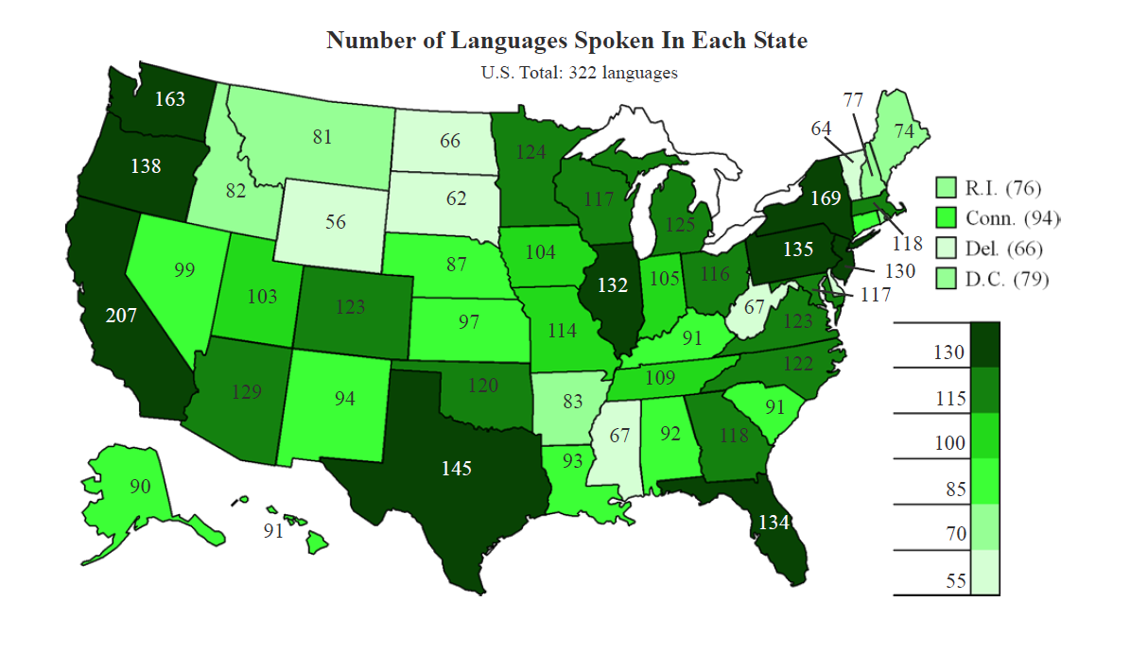
http://www.usefoundation.org/userdata/file/Research/states_by_languages.pdf

Slide 4
LATINO EMERGING SETTLEMENT PATTERNS, BY COUNTY, 2007 Source: Barcus, 2007

Slide 5
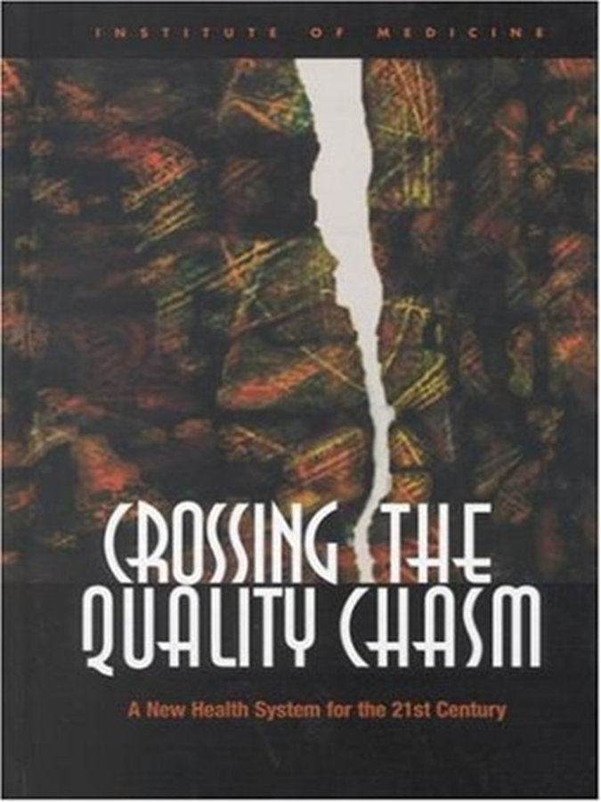
Our Nation Has Charted A Course Toward Quality Health Care
Quality Health Care
Health care should be
Safe
Effective
Patient-centered
Timely
Efficient
Equitable
Institute of Medicine. Crossing the Quality Chasm: A New Health System for the 21st Century. Washington D.C.: National Academy Press: 2001: 1-224.

Slide 6
LANDMARK STUDY ON DISPARITIES IN HEALTH CARE, IOM 2002
Disparities in Health Care
Racial/ethnic disparities found across a wide range of health care settings, disease areas, and clinical services, even when various confounders (SES, insurance) were controlled for
Findings
Many sources contribute to disparities—no one suspect, no one solution:
Provider-Patient Communication
Stereotyping
Mistrust
Recommendations
Cultural Competence training for a
ll health care professionals
Smedley BD, Sthith AY, Nelson AR, eds. Unequal Treatment:
Confronting Racial and Ethnic Disparities in Health Care.
Washington, D.C.: Institute of Medicine, Committee on
Understanding and Eliminating Racial and Ethnic Disparities
in Health Care;2003; 1-764.

Slide 7
CONCEPTUALIZING DISPARITIES IN HEALTH AND HEALTHCARE
Individual
Socio-demographics
Insurance
Health behaviors
Biology/genes
Beliefs/preferences
Perceived discrimination
Trust
Knowledge
Health Systems
Access
Organization
Quality
Culture
Financing
Location of care
Healthcare Disparities
Health
Disparities
Provider
Demographics
Knowledge and attitudes
Communication
Cultural competence
Bias and prejudice
Social/Environmental
Geography
Segregation
Exposures
Distribution of wealth
Living conditions
Social cohesion and norms
Kilbourne et al, Am J Public Health 2006

Slide 8
SPECIAL POPULATIONS
A health care provider is culturally competent when he/she is able to deliver culturally appropriate and specifically tailored care to patients with diverse values, beliefs, and behaviors
The goal of cultural competence is to improve the ability of doctors, nurses, pharmacists, among others, to communicate effectively with and provide quality health care to patients from diverse sociocultural backgrounds

Slide 9
RURAL POPULATIONS
A

Slide 10
LATINO/HISPANIC POPULATIONS
A

Slide 11
AFFICAN AMERICAN POPULATIONS
A

Slide 12
ASIAN/PACIFIC ISLANDER POPULATIONS
A

Slide 13
ASIAN/AMERICAN INDIAN POPULATIONS
A

Slide 14
NATIVE INDIAN POPULATIONS
A

Slide 15
LGBTQ POPULATIONS
A

Slide 16
CULTURALLY COMPETENT CARE
A health care provider is culturally competent when he/she is able to deliver culturally appropriate and specifically tailored care to patients with diverse values, beliefs, and behaviors
The goal of cultural competence is to improve the ability of doctors, nurses, pharmacists, among others, to communicate effectively with and provide quality health care to patients from diverse sociocultural backgrounds

Slide 17
HEALTH LITERACY IS INTEGRAL TO CULTURAL COMPETENCE
Patients leaving the physician’s office with a good understanding of what they are told
(Intermountain Healthcare study, 2005 – IOM)
http://www.lehman.edu/cuny-health-equity/documents/rose_marie_martinez.pdf

Slide 18
NEW SKILLS FOR PHYSICIANS TREATING 21ST CENTURY DIVERSE PATIENT POPULATIONS
How to conduct a culturally competent patient examination or history using the LEARN Model (Listen, Explain, Acknowledge, Recommend, Negotiate)
How lack of knowledge of epidemiological and pathophysiological differences may lead to unintended iatrogenic consequences
How to work with patients using qualified medical interpreters and ASL
Understanding the Law of Language Access (implications for informed consent, medical malpractice and other legal issues)
Given the increase in globally mobile populations, physicians should know their patients national origin and travel history and be mindful of diseases endemic to other parts of the world that might share symptoms with diseases commonly seen in the U.S.
SOURCE: Viewpoints

Slide 19
VIEWPOINTS OFFERS: FOR PHYSICIANS TREATING 21ST CENTURY DIVERSE PATIENT POPULATIONS (CONT’D)
Health care providers should be aware of at least the five most common infectious diseases encountered in refugee populations.
Cross-cultural medical ethics (examples: cultural differences around death and dying, blood beliefs, surgery, organ transplants, mental health, etc.)
Ethnopharmacology and its implications for current clinical practice
Understand the New Science of Unconscious Bias and its implications for clinical decision-making
Be able to take a comprehensive sexual history
Be able to take a competent patient history from immigrant and refugee patients

Slide 20
THANK YOU! Dr. Oralia G. Dominic oag102@psu.edu 814-574-1850

